Slide 1
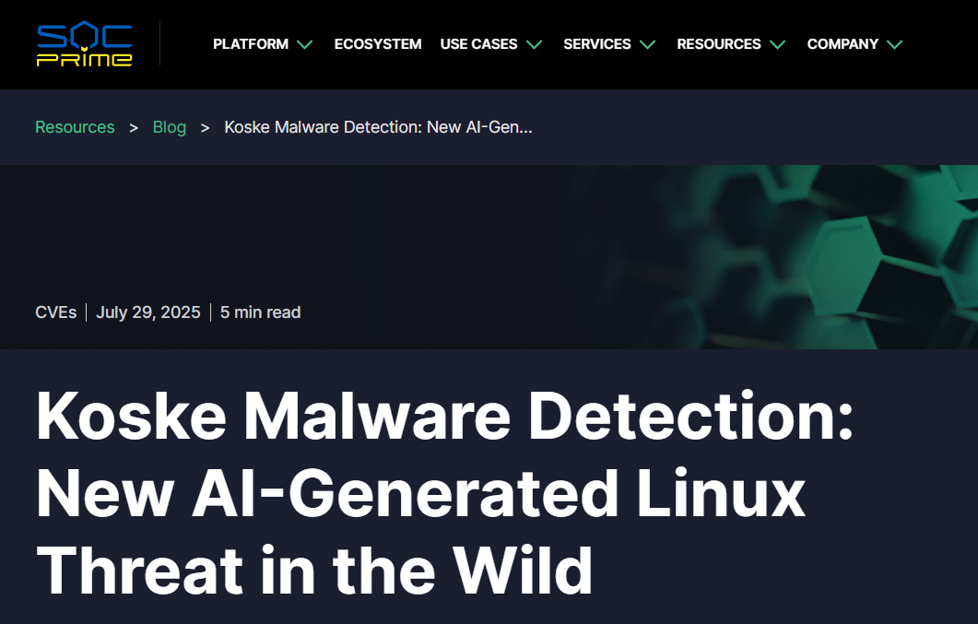
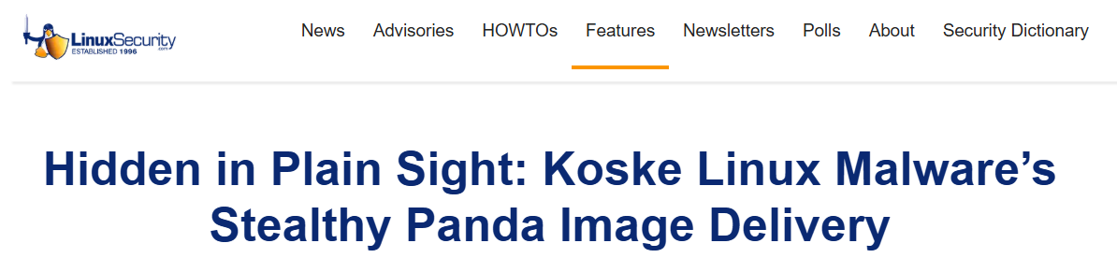
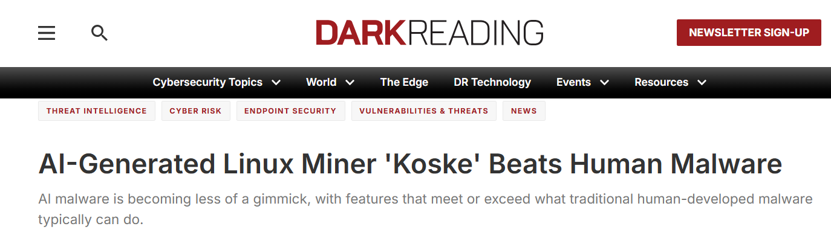
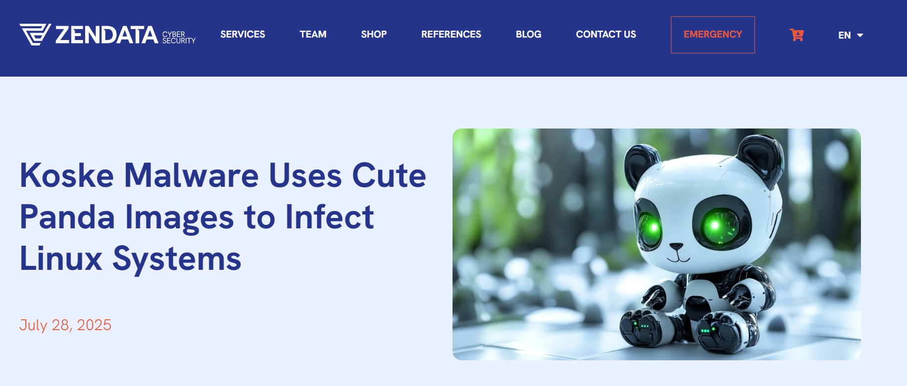
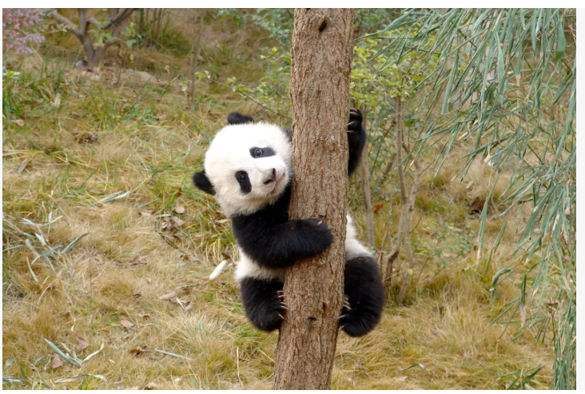

Slide 2
BackGround/Overview
Linux-Target Malware
Identified by Aqua Nautilus in July 2025
Believed it was developed with LLM or AI
Cryptocurrency Mining

Slide 3
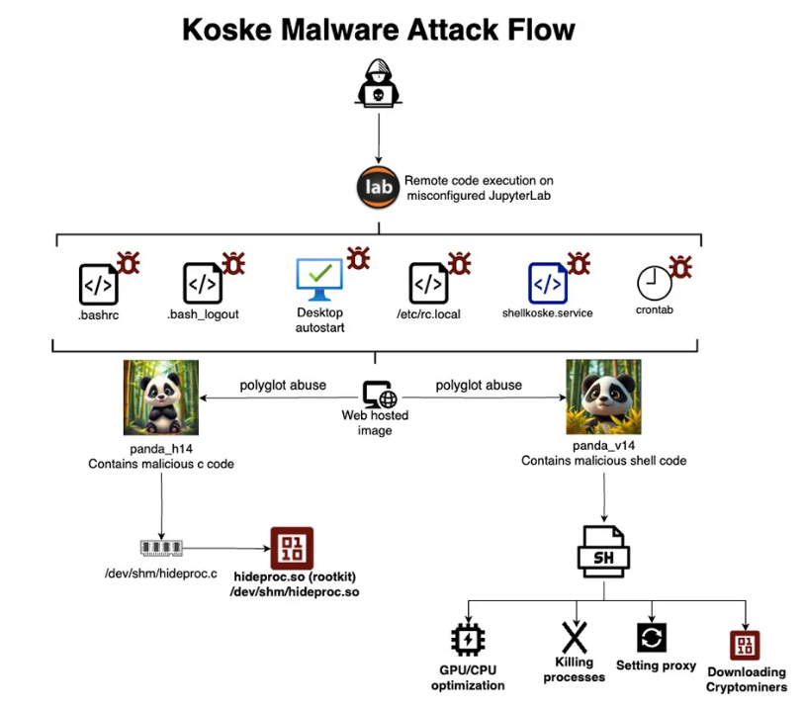
(1) Initial Access
(2) Downloads the polyglot images using scripts
(3) Bash Script for persistence and downloading of cryptominer
(3) Rootkit

Slide 4
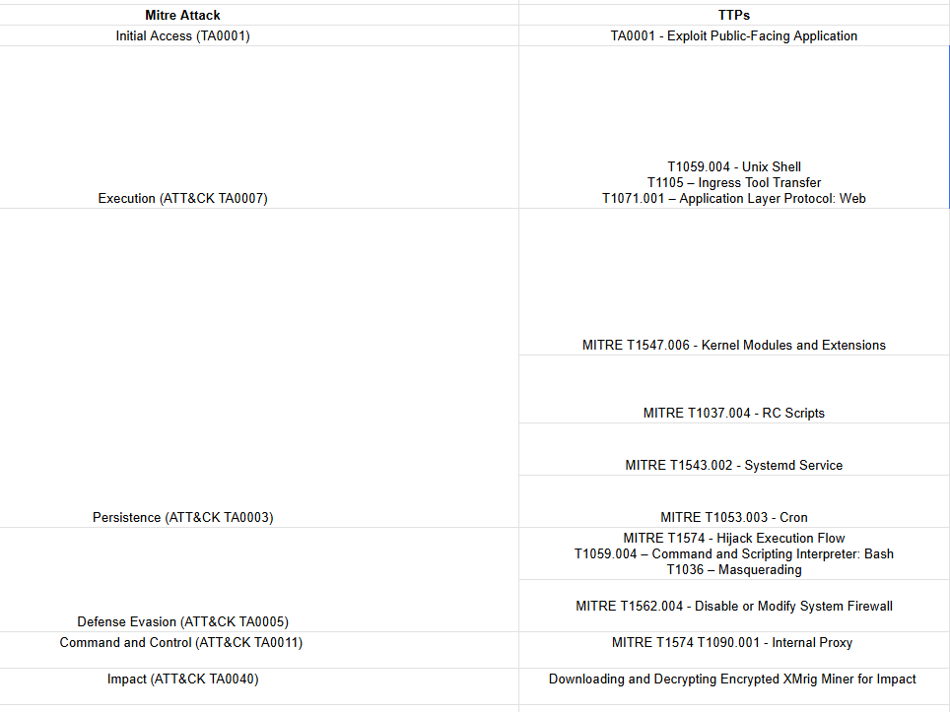
14 TTPs

Slide 5
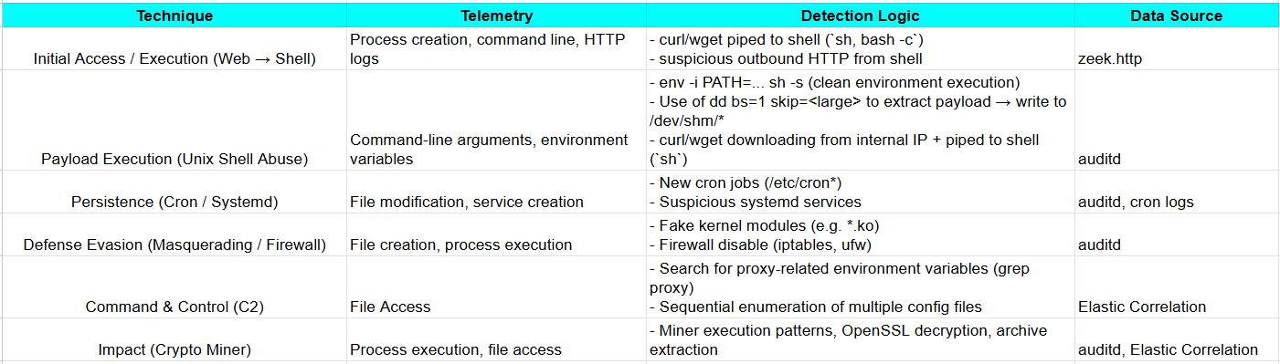
Detection Strategy

Slide 6
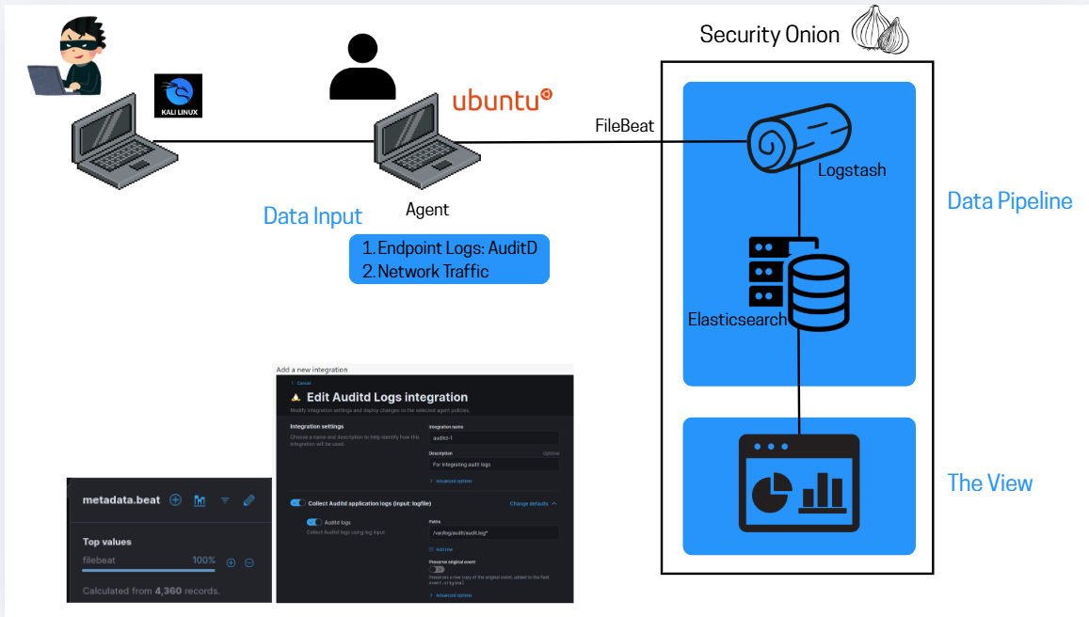

Slide 7
DEMO

Slide 8
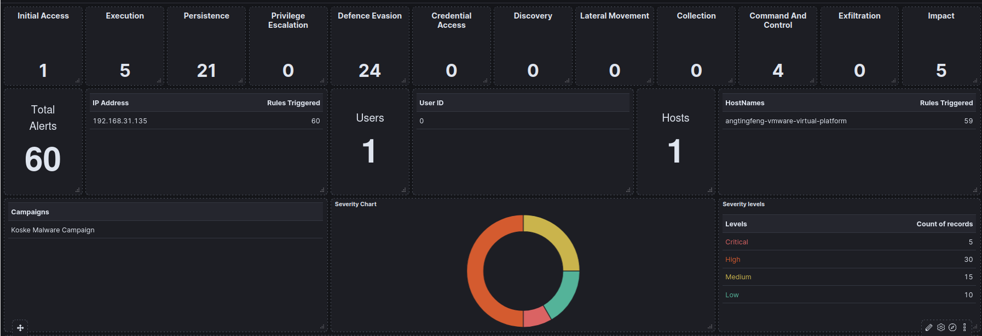

Slide 9
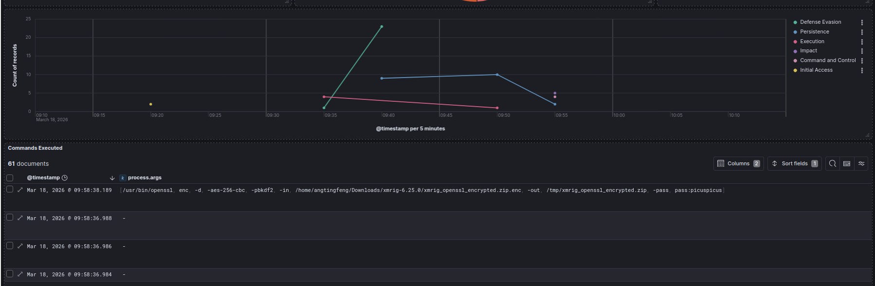

Slide 10
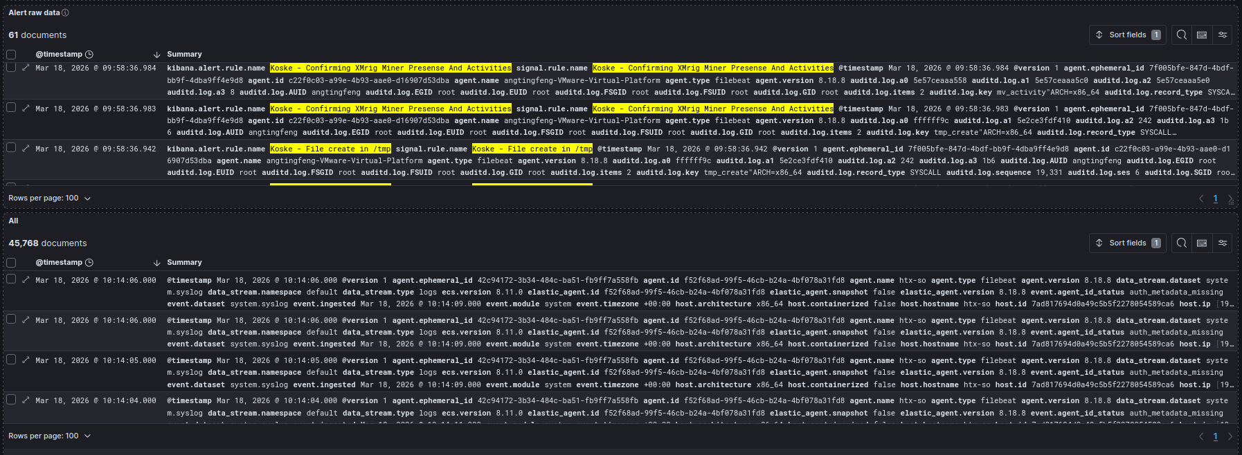

Slide 11
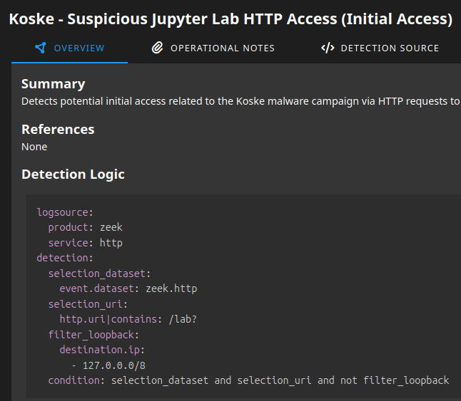

Slide 12
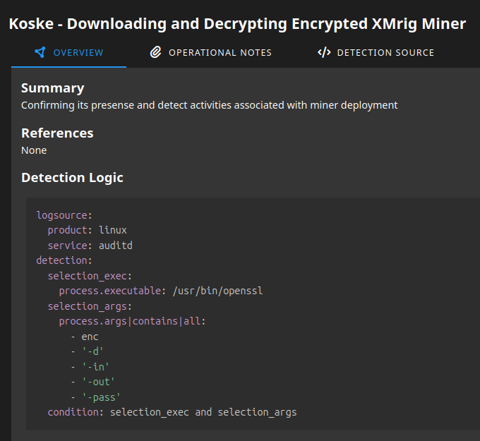

Slide 13
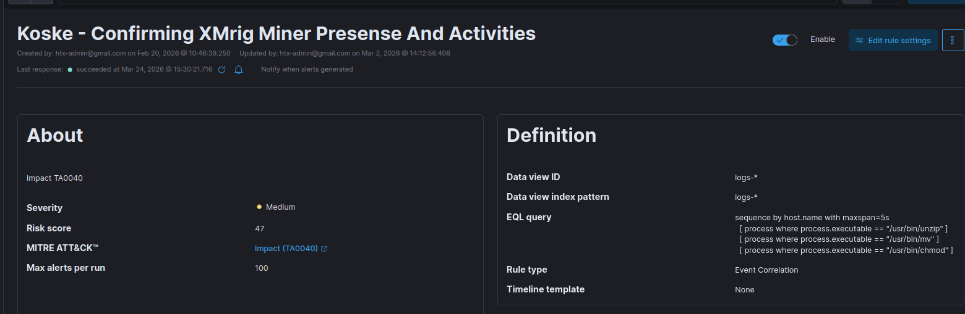

Slide 14
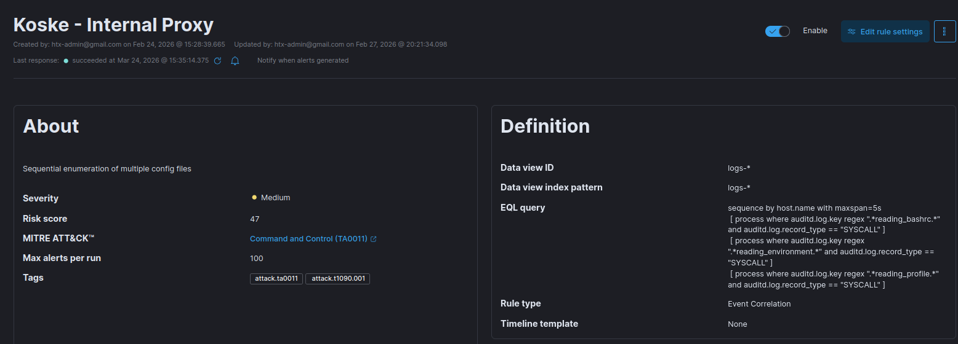

Slide 15
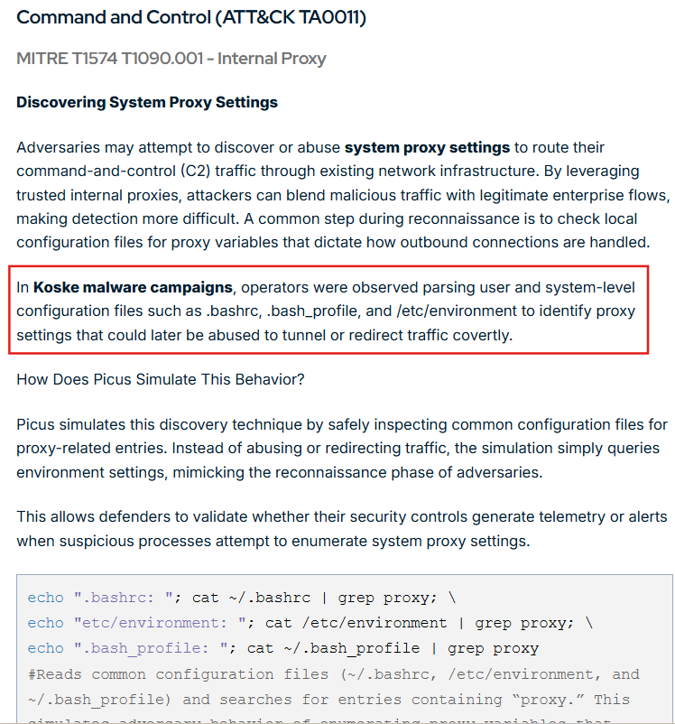

Slide 16
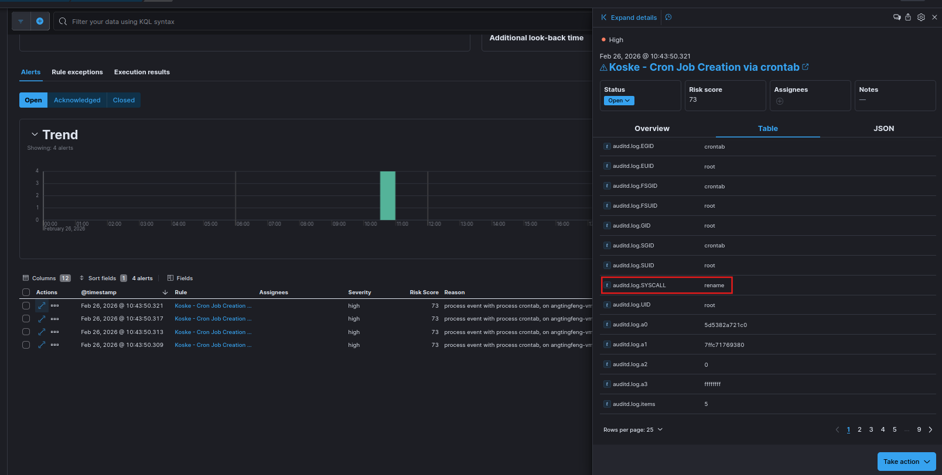
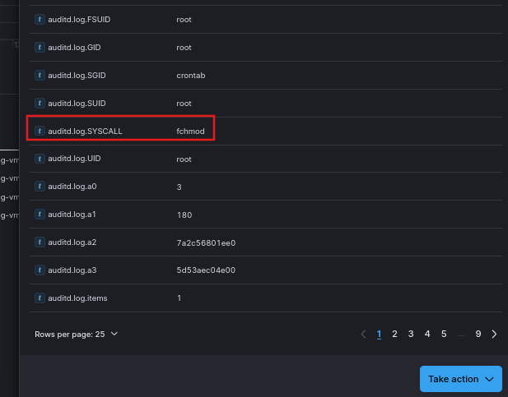
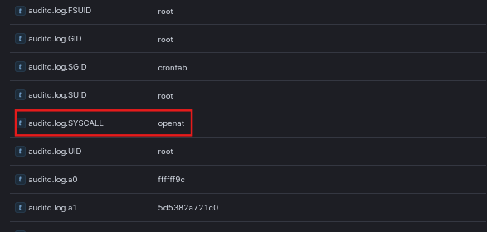
Notes on false positives and log enrichment ideas.

Slide 17
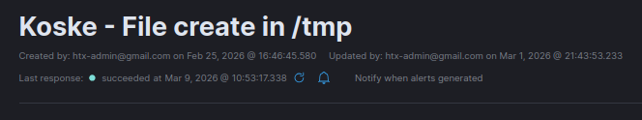
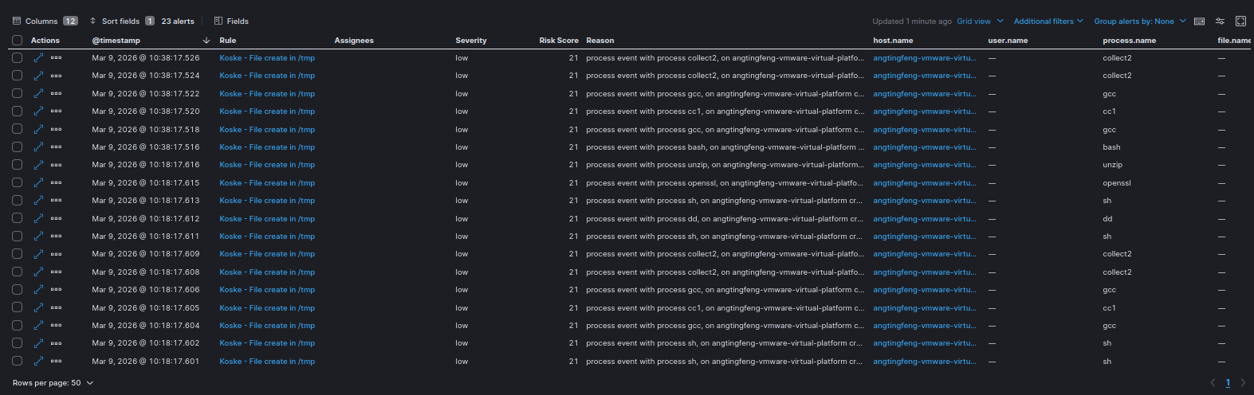
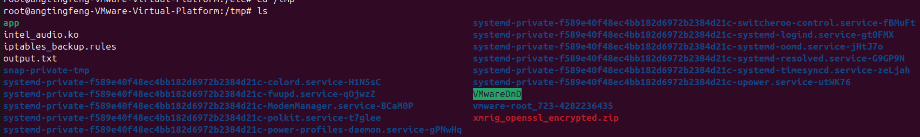

Slide 18
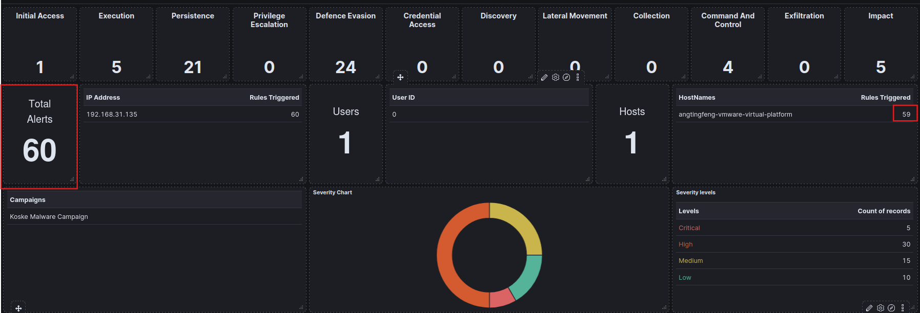

Slide 19
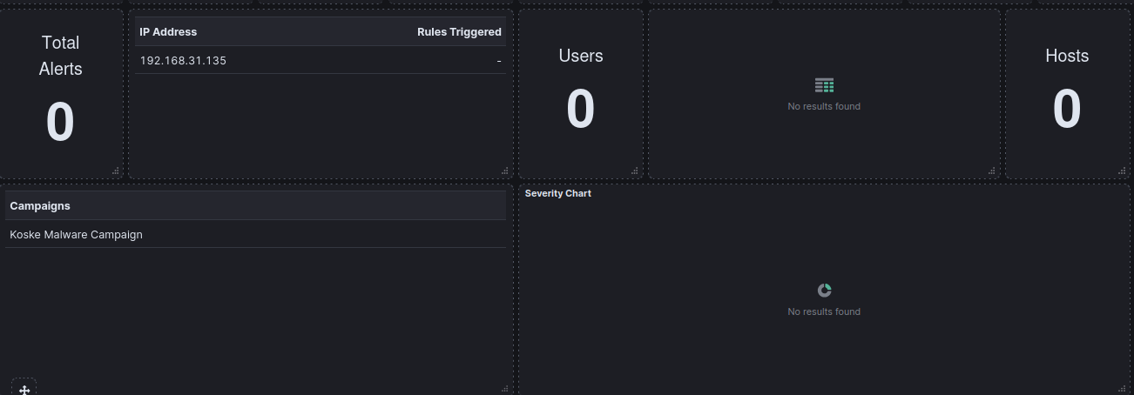

Slide 20
References:
https://www.aquasec.com/blog/ai-generated-malware-in-panda-image-hides-persistent-linux-threat/
https://www.darkreading.com/threat-intelligence/ai-generated-linux-miner-koske
https://socprime.com/blog/koske-malware-detection/
https://docs.google.com/presentation/d/1FMh5XzK3EWjncuJT9t8eDIPszJ1u0qtUxI0_CBM5Mzg/edit?slide=id.g3c78acc440d_0_59#slide=id.g3c78acc440d_0_59
https://zendata.security/2025/07/28/koske-malware-uses-cute-panda-images-to-infect-linux-systems/
https://www.picussecurity.com/resource/blog/explaining-the-ai-assisted-koske-linux-cryptomining-malware-hidden-in-jpegs

Slide 21
-a always,exit -F arch=b64 -S openat -F path=/etc/profile -F perm=wa -F auid>=1000 -F auid!=-1 -F key=modifications_of_environment_variables
-a: Add a rule
always, exit: always log when syscall exits
-F arch=b64: 64-bit System calls
-S execve: Monitors execve which is a syscall for opening a file
-F path=/etc/profile: Specific file path to monitor
-F perm=wa: Permission that is logged
- w: Write access to a file or directory
- a: Change in file’s or directory’s attribute
-F auid>=1000: Regular human users
-F auid!=-1: Exclude unset audit user ID
-k dd_activity: Assign a tag to the log

Slide 22
-a always,exit -F arch=b64 -S execve -F auid>=1000 -F auid!=-1 -F exe=/usr/bin/dd -k dd_activity
-a: Add a rule
always, exit: always log when syscall exits
-F arch=b64: 64-bit System calls
-S execve: Monitors execve which is a syscall for executing a binary
-F auid>=1000: Regular human users
-F auid!=-1: Exclude unset audit user ID
-F exe=/usr/bin/dd: Only log if the executed binary path is /usr/bin/dd
-k dd_activity: Assign a tag to the log

Slide 23
